Slide 1

BM Tech Bootcamps
An Introduction to Java Starter Bootcamp
What’s going to happen?

Slide 2

Introduction
Why Learn Java?
Career Opportunities
Java’s Impact
Our Learning Roadmap
Setting The Stage
Java Starter
Welcome to the Bootcamp!

Slide 3


Eyup Barlas
Introduction
Info about your instructor

Slide 4


Why Learn Java?

Slide 5

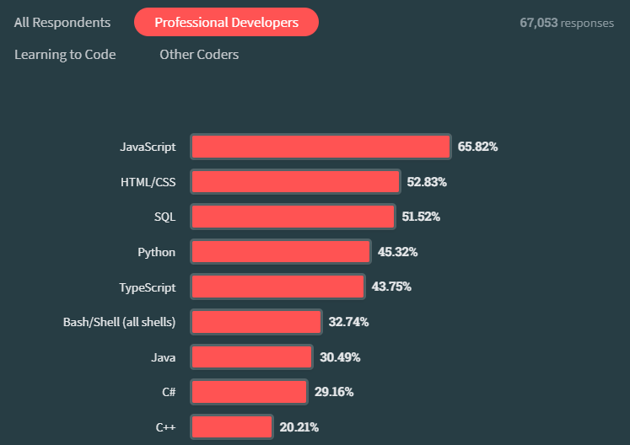


A passport to possibilities...
Industry Dominance / Career Growth
Java is a tech giant, driving major applications globally.
Highly valued skill in the job market.
Opportunities for diverse career paths and leadership roles.
Versatility / Portability
From backend systems to Android apps, Java does it all.
Ideal for developers seeking diverse projects.
Write once, run anywhere - Java's code portability across devices.
Community & Support
Join a thriving global community of Java developers.
Extensive resources and collaboration opportunities.
Stack Overflow Dev. Survey 2023

Slide 6
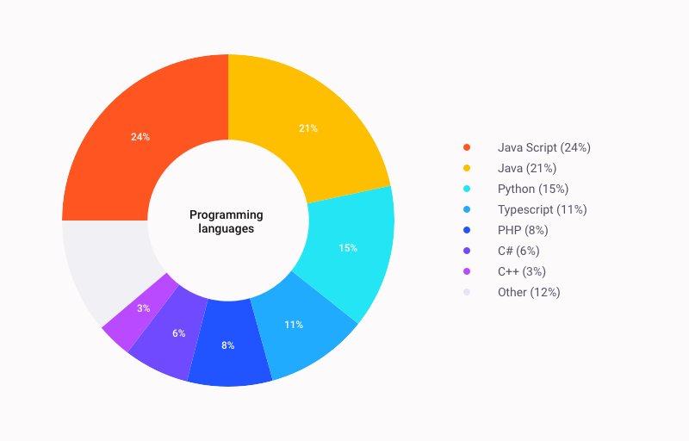

Career Opportunities
High Market Popularity in Poland
Java is used by 78.8% of Polish IT centers to create programs for laptops, data centers, game consoles, scientific supercomputers, mobile phones, and other gadgets
November 2023 - Poland Tech Market
Source

Slide 7
Java’s Impact
Type of Java Applications | Real-world Examples
Mobile Apps | Java is an open-source, cross-platform application used to develop apps that can run across mobile devices including smartphones, tablets, etc. It is the second most widely used language in the app development industry. Some examples of mobile apps developed using Java are Netflix, Spotify, Twitter, Google Earth, Uber and more.
Desktop Apps | Using Java, developers can create flawless and highly competitive desktop applications. Java offers an extensive library of responsive APIs such as JavaFX, Abstract Windowing Toolkit (AWT), and Swing that enables the development of modern GUI tools. Adobe Acrobat
Web-based Apps | Java can be used for developing web applications because of its ability to interact with a variety of systems. It enables dynamic web app development that allows interaction with interfaces. Amazon
Gaming Apps | Whether you want to build a 2D or 3D gaming app, Java is a powerful programming language as it includes a wide range of open-source frameworks. It is nearly impossible to build Android gaming apps without Java. Minecraft, Asphalt 6

Slide 8
Our Learning Roadmap
Week 1-4
Week 5-8
Week 9
Starting from scratch. Software Engineer’s workflow and Core Java Certification Preparation
Learning Spring Boot and Databases to create Web Applications - Learning Docker for containerization
Building a portfolio and hunting down jobs with proven techniques

Slide 9

Setting the stage
Software Engineer’s Workflow
Let’s overview which technologies we are going to use throughout the bootcamp.

Slide 10






For Coding
For Communication

Slide 11
Git and GitHub
Key technologies to develop software with other developers
Install Git
Create a GitHub Account
You can download Git here and then select your operating system to download.
Create an account on GitHub.com here.
Connect your GitHub to your Git account
You'll do this from your terminal.
To set your Git username, type this in your terminal:
git config --global user.name "Segun Ajibola"
To confirm that you have set your Git username correctly, type this:
git config --global user.name
You should have "Segun Ajibola" as the output. To set your Git email, type this in your terminal:
git config --global user.email "youremail@gmail.com"
To confirm that you have set your Git email correctly, type this:
git config --global user.email
You should have "youremail@gmail.com" as the output. You will be asked to authenticate your GitHub account, so just sign in with the same email to confirm.

Slide 12

Do you have any questions?
Thanks for your attention:)

